Slide 1

Exploratory Data Analysis
G2M Case Study
20/10/2022

Slide 2

Agenda
Data Summary
Problem Statement
Approach
EDA
EDA Summary
Recommendations

Slide 3
Background –G2M(cab industry) case study
XYZ is a private equity firm in US. Due to remarkable growth in the Cab Industry in last few years and multiple key players in the market, it is planning for an investment in Cab industry.
Objective : Provide actionable insights to help XYZ firm in identifying the right company for making investment.
The analysis has been divided into following parts:
Data Understanding
Data Visualization
EDA
Finding the most profitable Cab company
Recommendations for investment

Slide 4
Data Summary
22 Features( including 8 derived features)
Timeframe of the data: 2016-01-31 to 2018-12-31
Total data points :355,032
Assumptions:
Outliers are present in Price_Charged feature but due to
unavailability of trip duration details ,we are not treating this as outlier.
Profit of rides are calculated keeping other factors constant and only
Price_Charged and Cost_of_Trip features used to calculate profit.
Cab_Data.csv
Customer_ID.csv
Transaction_ID.csv
City.csv
Master Data

Slide 5
Problem Statement
To find out from the data of Pink Cab Company and Yellow cab Company, which is better to do an investment, so the investor XYZ can make a choice to invest.

Slide 6
Approach
Dataset provided is cab data, city data, customer data and transaction data in csv format. So data were merged into Master Data.
Performed analysis on KM Travelled, Cost of trip and Price Changed for Pink cab as well as Yellow cab.
Following steps are performed on dataset to gain some insights
Merge all csv files into Master Data.
Perform a quick review of dataset with seaborn.
Looked for correlation coefficient to find relation between variables.

Slide 7
EDA
Dataset used for EDA is Master data
Looked for missing data
Cleaned the dataset
Identified numerical and categorical features

Slide 8
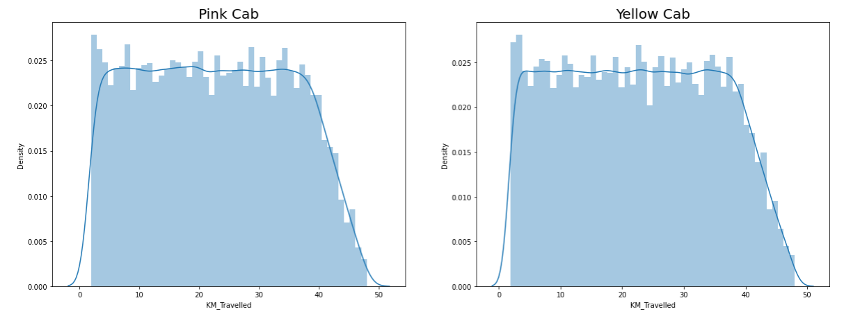
Profit Analysis
EDA
Above visualization shows that total distance travelled in KM for yellow cab as well as Pink cab is same, which is range from 2- 48 KM.

Slide 9
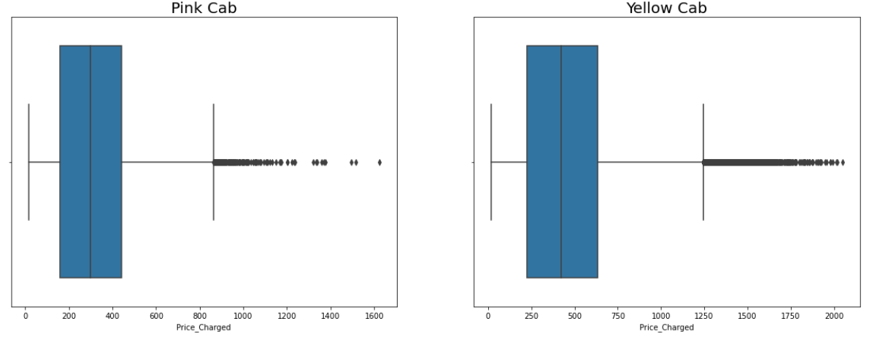
Profit Analysis
EDA
Above visualization shows that Price charged for yellow cab is greater than price charged for Pink cab.
Price charged for Box plot shows outliers. But they are not considered as outliers, as unavailability of trip duration.

Slide 10
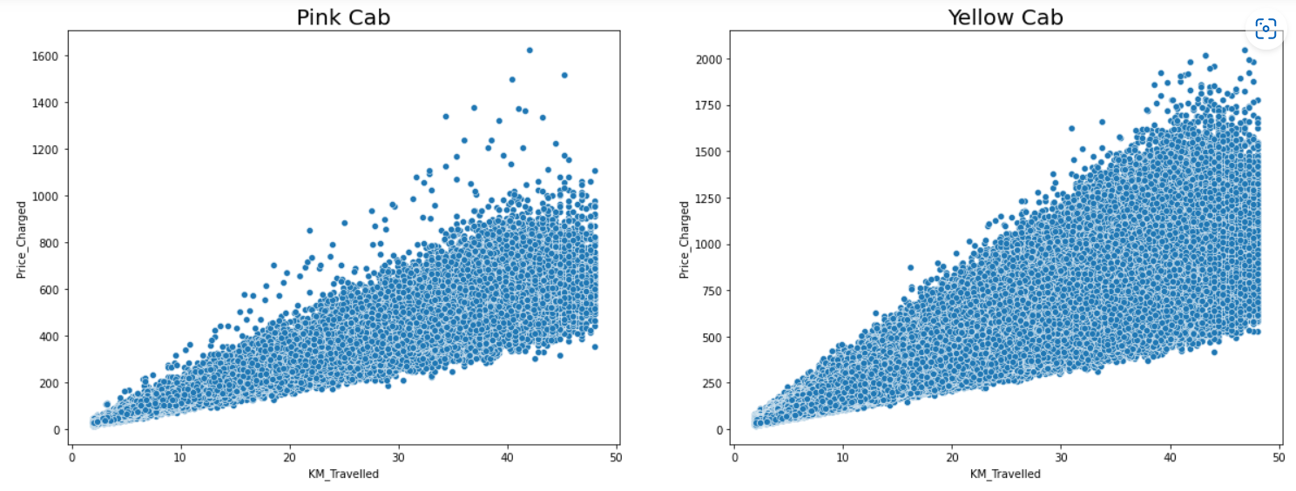
EDA
Yellow cab charged higher price as compared to Pink cab for same distanced travelled.

Slide 11
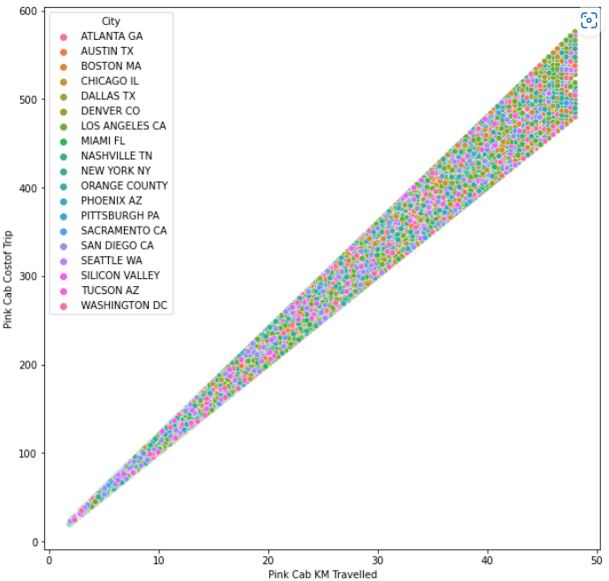
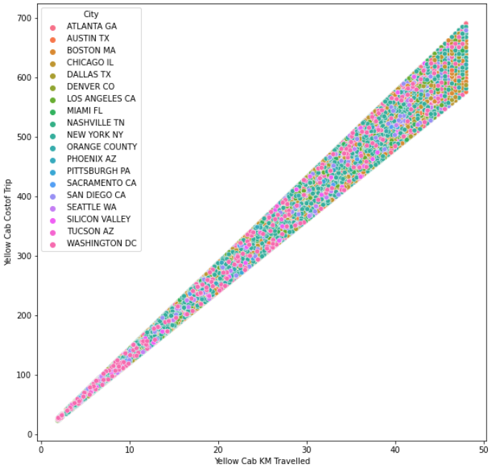
EDA
Yellow cab has higher profit margin as compared to Pink cab.

Slide 12
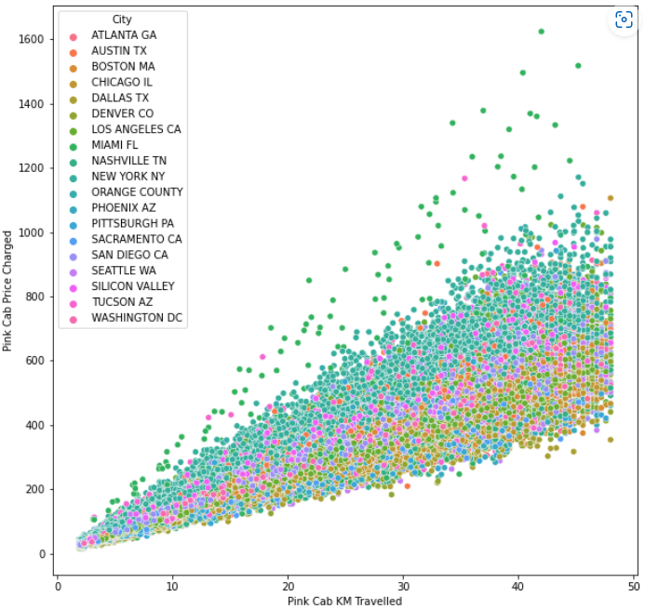
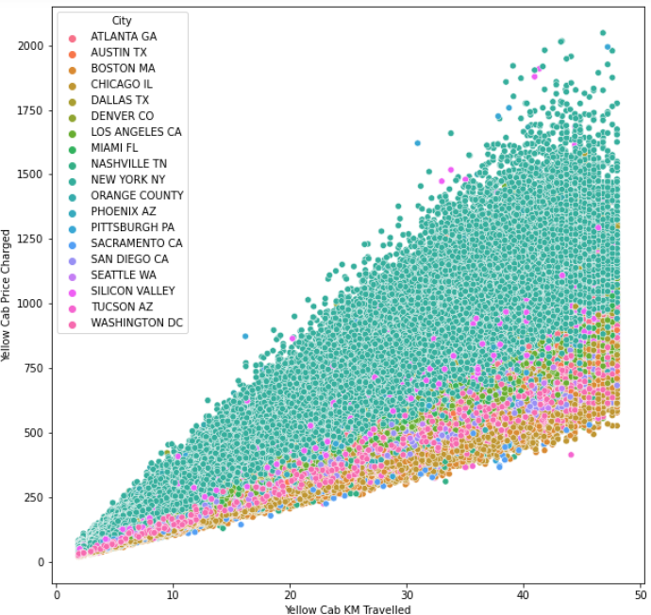
EDA
For New York City the Yellow Cab price charged is more in comparison to the other cities and for Pink cab all the cities have the same increase in prices with increase in distance

Slide 13
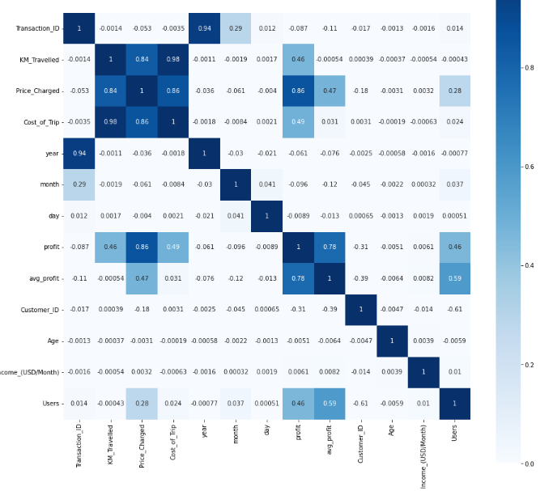
EDA
There is positive correlation between price changed and Profit Margin.

Slide 14
EDA Summary
Performed some operations on dataset and found that there is positive correlation between Margin and price charged.
Yellow cab charged more than Pink Cab
For New York City the Yellow Cab price charged is more in comparison to the other cities and for Pink cab, all the cities have the same increase in prices with increase in distance

Slide 15
Recommendation
I would recommend that investor should invest in Yellow cab as
Even if price charged is more for yellow cab than Pink cab, Margin is more for yellow cab.
There is price change only in New York city than any other city for yellow cab as New York is Metro Politian city so price is higher.

Slide 16
Thank You

